Slide 1
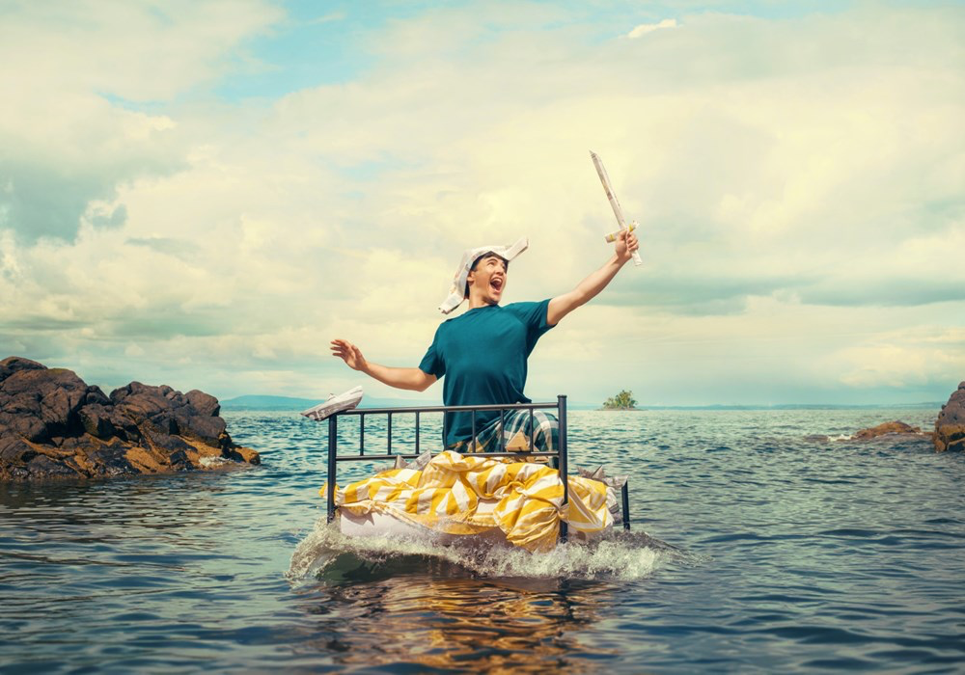


Slide 2
HELLO TEACHERS!
Thank you for joining Scottish Theatre Producers for our production of Treasure Island we hope you and your class had a wonderful time.
This creative resource is for you to use however you feel would be beneficial to you and your class. It was designed to be as
accessible and stress free as possible – we’ve added our suggestions of Curriculum for Excellence experiences and outcomes,
but it does not have to be limited to this. There are many ways in which you can use this resource pack. It has been designed to be
smartboard friendly. You could ask pupils to complete tasks individually, it could be used to link tasks together, it could be given
as homework tasks... this resource is a gift for you to use however you like. We have designed these activities so they can be easily accessible and engaging even for those who haven’t attended the performance or workshop. The main three skills this resource focuses on are Confidence, Creative Thinking and Teamwork. You will find all activities reflect this alongside direct links to expressive arts and literacy and English.
For tasks that don’t have a specific direction you can play with one of the following ideas…
•
Discussion – this could be a whole class discussion, discussion in smaller groups or pairs with someone feeding back
to the class.
•
•
Visually Create – mind map, draw, paint, photograph, if you have access to iPads there are many digital apps you can use.
Make Music – can the class work in a group to create sounds of the sea. Can the class use instruments, or do they
practice different sounds with their voices. Depending on digital resources this could be created through garage band.
•
Literacy – this could be a timed writing activity; you could select two songs and they must stop writing by the time
the music is finished.
You know your class best so do what works best for them and you.

Slide 3







HELLO PUPILS!
Thank you for joining us for our production of Ross MacKay’s’ Treasure Island! We hope you’ve been able to come and see the show, or that you plan to. Not to worry if not, you can still do all our Treasure Island based activities! We would love to hear about the work and conversations you have with these activities. Please feel free to contact us at any point by emailing Tanya, Scottish Theatre Producers Engagement Coordinator directly at: tanya.m.mclaughlin@gmail.com
TRIGGER WARNING
This is a story all about Pirates, so be warned you may see some ghastly sights. Please be prepared for scabby parrots, missing limbs, gunshots, blood... a fair bit of blood, fire and even death. In all seriousness, this might make you feel a bit queasy if you are of a sensitive disposition, and that is ok. But please remember it’s all done through the magic of theatre, and no one is ever in any real danger!

Slide 4



TREASURE ISLAND SYNOPSIS
Our version of Treasure Island is a story within a story. It all takes place in the smallest room of the smallest house on the smallest street. Our hero, Robbie has had a bad day at school. He has locked himself in his bedroom and he wants the whole world to just disappear.
He tries to forget about what has happened
by reading some of his favourite books, but it
isn’t working. But then, mysteriously, he finds
amongst his books a story he has never read
before. It is called Treasure Island – A story
about Jim Hawkins. The Bravest Boy in the
Whole Wide World.
As Robbie reads his imagination conjures up the world of the story around him and he
imagines what it would be like to really be
Jim Hawkins. Jim helps his mum run the
Admiral Benbow Inn. They haven’t had a
visitor for months until a strange pirate called
Billy Bones shows up. She demands a room
and stays for weeks but never pays a penny.
Billy dies and Jim takes her treasure map as
payment. But pirates come looking for the
map and burn the inn to the ground.
Jim feels guilty for taking the map and hiding
from the pirates. He promises his mum he will
find the treasure and that will pay to rebuild
the inn. Jim sets off and convinces a rich man
named Squire Trelawney to buy a boat to go
to Treasure Island.
Along the way Jim braves a storm at sea.
He fights pirates and befriends castaways
living on a desert island. He meets a parrot with
a suspicious past and he follows the map to
buried treasure. And more than once, Jim’s life
is on the line. But Jim learns bravery isn’t about
being always following rules; or doing whatever
it takes to win. Bravery is about doing what you think is right even if you are scared.
Back in the bedroom in Cumbernauld, Robbie
has almost stayed up the whole night reading
the story, imagining it all happening in front of
him. Robbie is amazed to learn that Jim can be
brave even when he is scared. Robbie thinks
perhaps that means he can be brave too and he
opens the bedroom door, ready to face the day,
filled with his newfound bravery.

Slide 5

INDEX
LET’S THINK
All About Treasure Island Five Things That…
6 8
LET’S CREATE
Time to design
Sucked into a book
Sea shanties
9 10 11
LET’S EVALUATE
Write a review
Your time to shine
12 14
RESOURCES
Sea shanty lyrics
Excerpts of the script breakdown
15 16
THANK YOU
17
CURRICULUM FOR EXCELLENCE,
EXPERIENCE AND OUTCOMES
18

Slide 6



LET'S THINK: ALL ABOUT
TREASURE ISLAND
1.
What do you think of when you hear Treasure Island?
2.
If you have already seen the performance, was it what you expected to see and hear?
If you’ve not seen it, have you read the Robert Louise Stevensons’ book, Treasure Island? Was that what you expected?
FURTHER ACTIVITY
There have been several adaptations of Robert Louise Stevensons’ Treasure Island, can you search online and find some? Have you seen one of these adaptations?
• If so, was it what you expected to see and hear?
• If not, why not watch it!
BLACKBEARD, SET HIS BEARD ON FIRE.
Edward Thatch or Teach, also known as Blackbeard, was one of the most feared pirates of all time. Before capturing a ship, he would weave hemp into his beard that he would set on fire, to strike fear into the ship’s crew.
6

Slide 7






LET'S THINK: ALL ABOUT TREASURE ISLAND
3.
What can you remember from the performance / book?
Don’t worry, if you’ve not seen or read it, create your own Treasure Island. Answer all the questions below to help you. Let’s think about the:
CHARACTERS
Who did we meet? What did they do? Where did they go? When did this happen? Why did the character feel or act the way they did? How did they make us feel? Did we like them or not?
Which character did you like the best? What made them your favourite?
PLOT/STORY
Who did the story follow? What was the story about? Where did the story take place?
When was the story set? Why did certain actions happen? How did it make us feel overall? How did specific
moments make us feel (like when the pirates burn down the inn, or when they land on the island)
OVERALL PERFORMANCE
What did the show look like? How did the show make us feel? How was the show presented?
Did you like it or not (explain why)? Did you like the music / props / set? Did anything surprise you in
the performance? Did the story remind you of anything that you have read, seen or heard before?
FURTHER ACTIVITY
In groups, can you recreate the entire performance in less that 2 minutes? • You have 10 minutes to rehearse in a group. • Remember what you learned in the workshop and use this to help you!
7

Slide 8



LET'S THINK: FIVE THINGS THAT
Robbie, the main character in this retelling, doesn’t feel brave. Especially in school. However, when he becomes Jim Hawkins, The Bravest Boy In the whole wide world, he can do anything! Including defeating pirates.
4.
Take a moment to think about the questions below.
You could write five points to answer each statement, draw them, or in small groups create freeze frames!
1.
2.
3.
4.
5.
I do that shows I’m brave.
Example – I stand up for others when they are being bullied.
Other people do that I think is brave.
Example – put their hand up in class to answer a question.
I’m scared to do but I will try.
Example – I’m scared to stand up in front of the class and talk but I will try.
Situations that I would need to be brave in.
Example – Fighting off a boatload of pirates
I can help someone else be brave
Example – by telling them that I’m not always brave, but by having friends and standing
by their side, we can do it together!
PIRATES FOLLOWED RULES.
Every pirate ship had a strict code of conduct known as articles that had to be followed. Some even had basic forms of welfare, making sure any pirate who became sick or impaired was still paid their share.
8

Slide 9



LET'S CREATE: TIME TO DESIGN
1.
We want you to design at least one of the following:
• •
•
A pirate ship. What you see when looking out a porthole.
Treasure Island.
Let’s get creative with the designs. You can:
•
•
•
Draw them on paper and paint them
Physically build them with objects in your classroom
Take it digital and use an app like ipastals / photoshop / assembly… to create.
PIRATES DIDN’T HAVE PET PARROTS. There are no records of pirate ships keeping parrots as a pet. This myth seems
to have been created by Robert Louis Stevenson. In his book Treasure Island,
the pirate Long John Silver had a pet parrot called Captain Flint.
FURTHER ACTIVITY
If you’re they type of class that love to make things, then we recommend checking out some pirate themed origami videos. These were our favourites. https://youtube.com/playlist?list=PLHX1llegCDZoKGakI39wvrbz5w3VLJrmp
If this doesn’t work, search for origami parrots and pirate boats. You can make parrots that will sit on your finger, and boats
that you can race in the water.
9

Slide 10



LET'S EVALUATE: SUCKED INTO A BOOK!
2.
What’s your favourite book? Write a synopsis/blurb about it.
If you can’t think of a favourite, what are you reading as a class just now.
3.
Now, are you ready for a crossover? How could you and your friends add yourselves into the book?.
• Do you get sucked in and become the main character like what happens to Robbie when he becomes Jim? • Do your friends become characters in the book? • Do you go in as yourself and become friends with the hero of your book? • Do you go on the same adventures? If so, how do you help them, or make it worse? • Do you go on new adventures with the hero of your book? If so, what are they?
Create a storyboard (you can do this digitally with sites like https://www.storyboardthat.com or apps like Comic Draw)
and/or write a script / first few chapters of a book!
FURTHER ACTIVITY
• What can you find out about the original Treasure Island author Robert Louis Stevenson? • We’ll give you a starting point, he’s Scottish! • Can you find any more work by Scottish authors? What about our own Ross MacKay! • Could you copy their writing style and create a story / poem that is similar? • Are you looking at a time in history where you could look at authors too? • Next time you have a literacy lesson you could create a blurb and front cover for your work too. • Could you give your story to a friend to read? • They might give a quote to put on your book that encourages someone else to read it.
10

Slide 11


LET'S CREATE: SEA SHANTIES
Some historians think eye patches were not just worn due to missing eyes. An eye patch was instead worn so that one eye would al- ways be adjusted to the darkness below deck. This meant when you went below deck you didn’t need to wait for your eyes to adjust.
Sea Shanties
In the performance we hear the pirates sing sea shanties. One of our shanties in the show - The Gold Will Fill - goes like this. To find the
lyrics, click here Most sea shanties were made by writing new words to already well-known tunes. Our sea shanty The Gold Will Fill is
based on The Rattlin Bog.
4.
Now it’s time for you to make your own! Can you make a shanty for your morning routine, or the school day?
Songs like shanties are a fun and memorable way of passing information on. It can also make a boring task fun and easier to do! The important thing to remember is:
• Shanties have a good, strong ‘heartbeat’.
• Try and count the number of syllables in the line. When you rewrite the words stick to the same number of syllables in each line.
• If you need an extra syllable in a line, then use a pirate sound.
Arrr!
Oh!
Hey-Ho!
• If you get stuck, list out as many words as you can that might be used by a pirate. Words like:
Telescope
Sails
Treasure
• Pick some of these words and see if you can fit them into the song.
FURTHER ACTIVITY
• Are there any famous ship journeys you could research; imagine you were on that voyage.
Where do you go and what do you do?
• Are you exploring any historical figures? What kind of music would they listen to?
• What famous pirates can you find? Real or fictional.
11

Slide 12


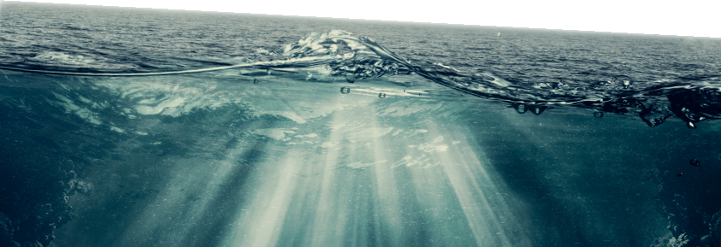
LET'S EVALUATE: WRITE A REVIEW!
1. 2. 3.
How many stars would you give this performance? Why did you give it this?
What did you enjoy the most?
WOMEN CAN BE PIRATES TOO.
Although the vast majority of pirates were men,
there were women pirates as well. Pirates such
as Mary Read and Anne Bonney became famous
for their exploits. Some women would also pose
as men to board pirate ships, meaning there
might have been many more women on these
ships than records suggest.
Sentence Starters!
From the moment it started, I was captivated by....
The best part of this experience was..
A major highlight for me was..
One area where this could improve is..
While there were some strengths, a key drawback was..
Compared to similar shows, this one..
I would highly recommend this to anyone who...
12
FURTHER ACTIVITY
• Can you physically act this out? • You’ll find 3 extracts of the script that was sent out to you alongside this pdf.

Slide 13



LET'S EVALUATE: REVIEWS ARE IN!
Your local newspaper has been informed that you’ve seen Scottish Theatre Producers production
of Treasure Island and ask for a review.
5.
What do you tell them?
When writing a review, try to include: • Name of the production, name of the theatre company, the venue, and date of the performance.
• Summary of the performance but avoid spoilers!
• Your opinion – what you really thought of the show. People are interested in your opinion, but remember, people can disagree
with you. Justify why you’re saying what you’re saying but remember, we all have feelings so don’t be mean about it. In this you could answer questions like:
• How did you feel at the start and then the end of the performance?
• Did the performance make you think of anything?
• What do you think about the characters / the plot / the costume / the set / the music and sounds ect.
• Give details, if you thought something was amazing WHY, if you thought it was boring WHY?
• Would you recommend the reader to go and see the production?
FURTHER ACTIVITY
• Do you have a school newspaper / e-letter that this could be published in?
• Can it be filmed as an interview?
13

Slide 14






LET'S EVALUATE: YOUR TIME TO SHINE!
4.
If you were the director, writer or actor what would you change about the story?
• Is there another way this could have been shown? Show us! • Did you have questions that were left unanswered? Can you find a way to answer them? • If you were to perform this back, what would you do differently?
FURTHER ACTIVITY
• Can you physically act this out? • You’ll find 3 extracts of the script that was sent out to you alongside this pdf.
By clicking here you will find a brief breakdown of each scene
• Can you work in groups each having at least one director, one writer, and two actors?
• Are you happy to present it back to the rest of the class?
• Groups could even write a review on peer performances!
PIRATES WORE EYE PATCHES. Pirates wore eye patches. Some historians think eye patches were not just worn due to missing eyes. An eye patch was instead worn so that one eye would always be adjusted to the darkness below deck. This meant when you went below deck you didn’t need to wait for your eyes to adjust.
14

Slide 15

RESOURCES: SEA SHANTY LYRICS
CHORUS: Ho ro we got our gold. The gold will fill our galley-o. Real gold, the pirate’s gold. The gold will fill our galley-o.
VERSE 1: Oh, the real gold was in a chest. A rare chest and a pirates chest And the gold in the chest And the gold will fill our galley-o
CHORUS
VERSE 5:
Well, the real rock marked by a cross.
A rare cross and a pirate’s cross.
And the cross on the rock. And the sand by the rock.
And the hole in the sand. And the chest in the hole.
And the gold in the chest And the gold will fill our galley-o.
CHORUS VERSE 2: Oh, the real chest was in a hole. A rare hole and a pirate’s hole And the chest in the hole. And the gold in the chest And the gold will fill our galley-o
CHORUS VERSE 6: Oh, the real cross was on this map. A rare map and a pirate’s map. And the map with a cross. And the cross on the rock. And the sand by the rock. And the hole in the sand. And the chest in the hole. And the gold in the chest And the gold will fill our galley-o
CHORUS VERSE 3: Well, the real hole was in the sand. A rare sand and a pirate’s sand. And the hole in the sand. And the chest in the hole. And the gold in the chest. And the gold will fill our galley-o
CHORUS Ho ro we got our gold. The gold will fill our galley-o. Real gold, the pirate’s gold. The gold will fill our galley-o.
CHORUS VERSE 4: Oh, the real sand was by a rock. A rare rock and a pirate’s rock. And the sand by the rock. And the hole in the sand. And the chest in the hole. And the gold in the chest And the gold will fill our galley-o
15

Slide 16

RESOURCES: EXCERPT OF THE SCRIPT BREAKDOWN
1.
The Bravest Boy in all the World
This can be 2 or 4 actors. It is 2 pages long. Long John Silver has just burned down the Admiral Benbow Inn. Maggie and Jim are standing outside talking
2.
Exploring the Island
This is for 2 actors. It is 2 pages long. Jim has left Captain Smollett and Squire Trelawney hiding in a cave while he has taken the map to go and
find Captain Flints treasure. On his travels he meets Ben Gunn.
3.
Finding the Treasure
This is for 4 actors. It is 3 pages long. Jim and Ben Gunn have just found the treasure and dug the chest up. They can hear Long John Silver coming
in and Benn Gunn wants to run away. Jim persuades her to stay and to do her Captain Flint impression, after all,
Long John is terrified of Captain Flint
16

Slide 17








Creative Team
Assistant Stage Manager
Ali Biggs
Performer
Anthony O'Neil
Set and Costume Designer
Becky Minto
Lighting Designer
Benny Goodman
Technical Stage
Manager (Sound)
Ben Morgan
Production Manager
Craig Fleming
Fight director
EmmaClaire Brightlyn
Stage Manager
Emma Skaer
Director
Jordan Blackwood
Technical Stage Manager (Lighting)
Jamie Murray
Movement Director
Lucy Wild
Performer
Megan McGuire
Composer
Oğuz Kaplangı
Writer
Ross MacKay
Producer
Sarah Gray
Performer
Simon Donaldson
Wardrobe Supervisor
Sophie Ferguson
Performer
Stephanie MacGaraidh
Production Manager
Suzie Normand
Engagement co-ordinator
Tanya McLaughlin
Thanks to:
Ailie Cohen, Richard Price, National Theatre of Scotland, Tron Theatre, Scottish Opera, Visible Fictions, Cumbernauld Theatre, Pretty Scenic, James Gardner, Blue Parrot and everyone who has supported this project.

Slide 18

CURRICULUM FOR EXCELLENCE - EXPERIENCE AND OUTCOMES
Let’s Think Expressive arts Art and design
• I have the opportunity to choose and explore an extended range of media and technologies to create images and
Drama
objects, comparing and combining them for specific tasks. EXA 2-02a
• I can respond to the experience of drama by discussing my thoughts and feelings. I can give and accept constructive
comment on my own and others’ work. EXA 2-15a
• I can create, adapt and sustain different roles, experimenting with movement, expression and voice and using theatre
arts technology. EXA 2-12a
Literacy and English
Listening and talking
Writing
• When I engage with others, I can respond in ways appropriate to my role, show that I value others’ contributions and
use these to build on thinking. LIT 2-02a
• When listening and talking with others for different purposes, I can:
•
•
•
•
share information, experiences and opinions
explain processes and ideas
identify issues raised and summarise main points or findings
clarify points by asking questions or by asking others to say more. LIT 2-09a
• I enjoy creating texts of my choice and I regularly select subject, purpose, format and resources to suit the
needs of my audience. LIT 2-20a
• I can convey information, describe events, explain processes or combine ideas in different ways. LIT 2-28a
Technologies
Craft, Design, Engineering and Graphics
• I can use a range of graphic techniques, manually and digitally, to communicate ideas, concepts or products,
experimenting with the use of shape, colour and texture to enhance my work. TCH 2-11a
18

Slide 19

CURRICULUM FOR EXCELLENCE - EXPERIENCE AND OUTCOMES
Let’s Create Expressive arts Art and design
• I have the opportunity to choose and explore an extended range of media and technologies to create images and
objects, comparing and combining them for specific tasks. EXA 2-02a
• I can create and present work that shows developing skill in using the visual elements and concepts. EXA 2-03a • Inspired by a range of stimuli, I can express and communicate my ideas, thoughts and feelings through activities
within art and design. EXA 2-05a
Music
• I can sing and play music from a range of styles and cultures, showing skill and using performance directions,
and/or musical notation. EXA 2-16a
• Inspired by a range of stimuli, and working on my own and/or with others, I can express and communicate my ideas,
thoughts and feelings through musical activities. EXA 2-18a
• I have listened to a range of music and can respond by discussing my thoughts and feelings. I can give and accept
constructive comment on my own and others’ work. EXA 1-19a / EXA 2-19a
Literacy and English
Reading
Writing
• Using what I know about the features of different types of texts, I can find, select and sort information from a variety
•
of sources and use this for different purposes. LIT 2-14a
I can:
•
•
•
discuss structure, characterisation and/or setting
recognise the relevance of the writer’s theme and how this relates to my own and others’ experiences
discuss the writer’s style and other features appropriate to genre. ENG 2-19a
• Having explored the elements which writers use in different genres, I can use what I learn to create stories, poems and
plays with an interesting and appropriate structure, interesting characters and/or settings which come to life. ENG 2-31a
19

Slide 20

CURRICULUM FOR EXCELLENCE - EXPERIENCE AND OUTCOMES
Let’s Evaluate Health and well-being Mental and emotional wellbeing
• I am aware of and able to express my feelings and am developing the ability to talk about them. HWB 2-01a
Literacy and English
Listening and talking
• I can select ideas and relevant information, organise these in an appropriate way for my purpose and use suitable
vocabulary for my audience. LIT 2-06a
• I can show my understanding of what I listen to or watch by responding to literal, inferential, evaluative and other
Writing
types of questions, and by asking different kinds of questions of my own. LIT 2-07a
• I consider the impact that layout and presentation will have and can combine lettering, graphics and other features to
engage my reader. LIT 2-24a
• By considering the type of text I am creating, I can select ideas and relevant information, organise these in an appropriate
way for my purpose and use suitable vocabulary for my audience. LIT 2-26a
• I can convey information, describe events, explain processes or combine ideas in different ways. LIT 2-28a
20

Slide 21

CURRICULUM FOR EXCELLENCE - EXPERIENCE AND OUTCOMES
Engaging with the Performance / Workshop Expressive arts Participation in performances and presentations
• I have experienced the energy and excitement of presenting/performing for audiences and being part of an audience for other
Drama
people’s presentations/performances. EXA 2-01a
• Inspired by a range of stimuli, I can express and communicate my ideas, thoughts and feelings through drama. EXA 2-13a
• I can create, adapt and sustain different roles, experimenting with movement, expression and voice and using theatre arts
technology. EXA 2-12a
• I have created and presented scripted or improvised drama, beginning to take account of audience and atmosphere.
EXA 2-14a
Health and well-being
Mental and emotional wellbeing
• I make full use of and value the opportunities I am given to improve and manage my learning and, in turn, I can help to
encourage learning and confidence in others. HWB 2-11a
• Through contributing my views, time and talents, I play a part in bringing about positive change in my school and wider
community. HWB 2-13a
• I value the opportunities I am given to make friends and be part of a group in a range of situations. HWB 2-14a
Physical education
• As I encounter new challenges and contexts for learning, I am encouraged and supported to demonstrate my ability to
select, adapt and apply movement skills and strategies, creatively, accurately and with control. HWB 2-21a
Literacy and English
Listening and talking
•
I am developing confidence when engaging with others within and beyond my place of learning. I can communicate in a clear,
expressive way and I am learning to select and organise resources independently. LIT 2-10a
21

